Slide 1
Quantify UN
SDGs
Pravesh Agarwal | Pierce Gruidl | Jay Morris | Pratikshya Prasai

Slide 2
Motivation
Scattered data is hard to understand without effort. Bring SDG data together to visualize our progress towards it.

Slide 3
Approach
Data Scraping and APIs
Data Visualization and Communication
Make a simple dashboard to give summary statistics
Notes:
Jay

Slide 4



Data
Hunger
Environment
Quality Education
Too much data,
defining appropriate Measure

Slide 5

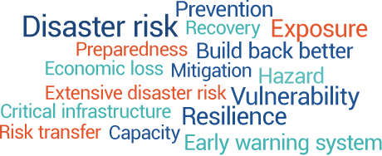
Getting Data
Scraping:
APIs: World Bank
Notes:
pierce

Slide 6
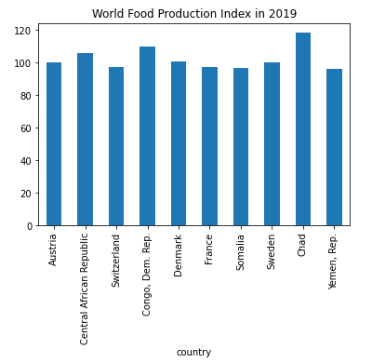
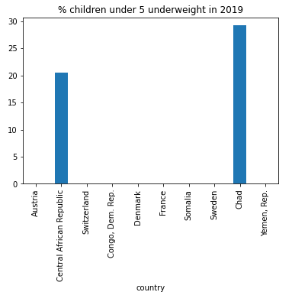
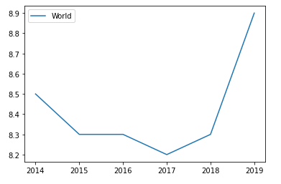
Hunger
Notes:
jay

Slide 7
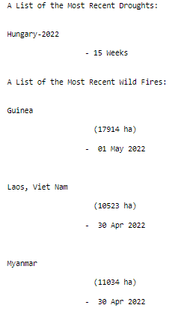

Natural Disasters
Information source of recent world Natural Disasters: earthquakes, tropical storms, floods, volcanoes, droughts, and wildfires.
Web Scraping
Notes:
pierce

Slide 8
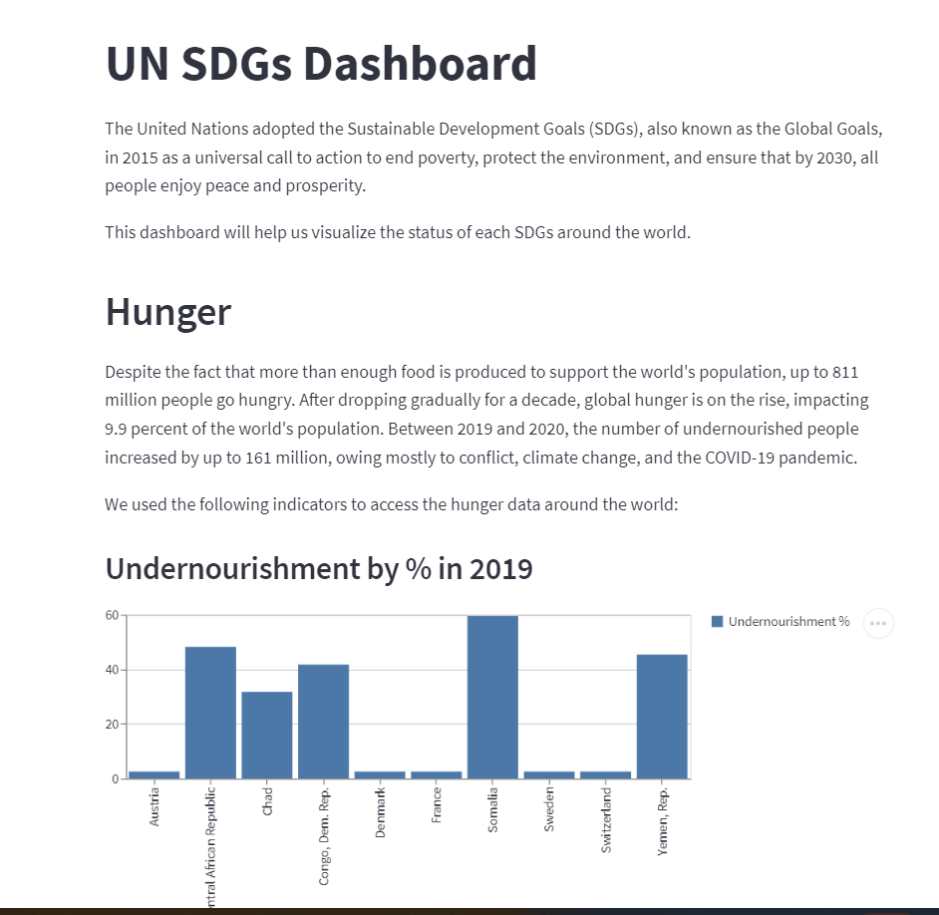

Notes:
pratikshya

Slide 9

Future Steps
Lot of data pipeline building
Data update automation
Complex Dashboard

